Slide 1
Software Design & Architecture Lecture 1
SESD-2222
Fall 2024
Maria Kiran
maria.kiran@ucp.edu.pk
Office: Building A, Faculty Hall F202
OFFICE HOURS: Tuesday : 02:00 PM- 04:00 PM
Friday: 11:00 AM- 01:00 PM

Slide 2
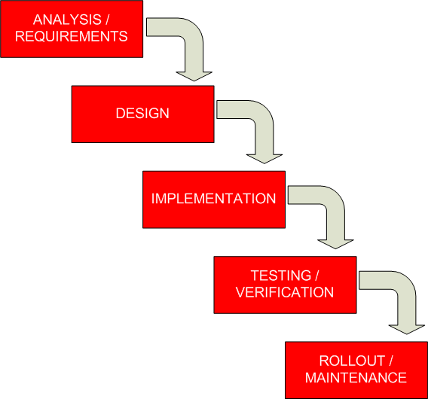
Software Design
Software Design
What is Design?
Why Design is so important?
Levels of Design
The Design Process

Slide 3
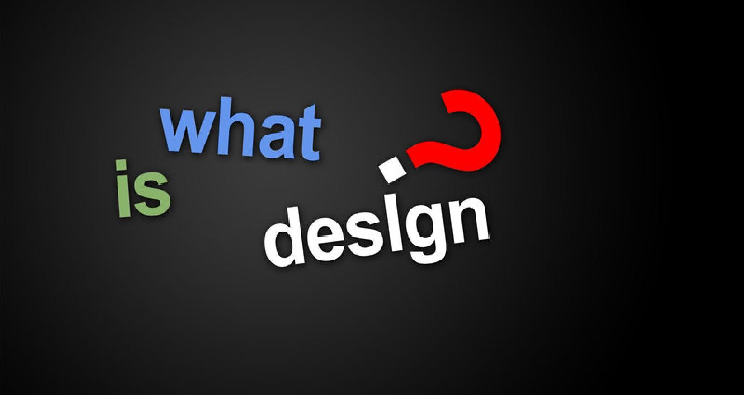
What is Design?
Design is the creation of a plan or convention/agreement for the construction an object or the system.

Slide 4
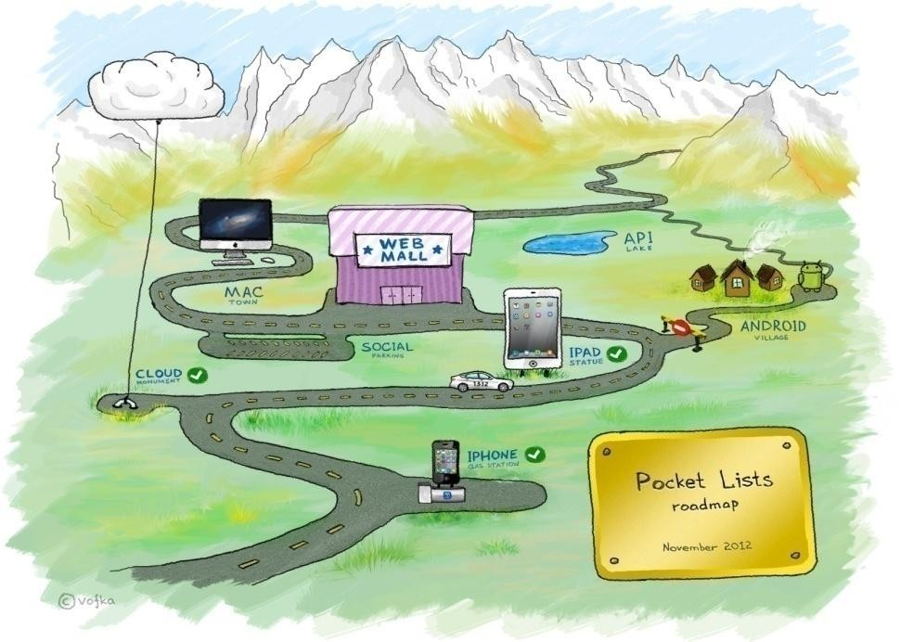
What is Design?
Another definition for design is a roadmap or a strategic approach for someone to achieve a unique expectation. It defines the specifications, plans, parameters, costs, activities, processes and how and what to do within legal, political, social, environmental, safety and economic constraints in achieving that objective.

Slide 5
Software Design
There are two ways of constructing a software design: One way is to make it so simple that there are obviously no deficiencies, and the other way is to make it so complicated that there are no obvious deficiencies.”
- C.A.R. Hoare

Slide 6
Software Design
Requirements specification was about the WHAT the system will do
Design is about the HOW the system will perform its functions.
Design provides the overall decomposition of the system
Design allows to split the work among a team of developers
Design also lays down the groundwork for achieving non-functional requirements (performance, maintainability, reusability, etc.)
Design takes target technology into account (e.g., database design, etc.)

Slide 7


Why Design is so Important?
Design it so that it connects with the end-user

Slide 8
Levels of Design
Two basic Levels of Design:
Architectural design (also: high-level design)
the overall structure main modules and their connections
design that covers the main use-cases of the system
Addresses the main non-functional requirements(e.g., throughput, reliability)
hard to change
Note: A high-level design document will usually include a high- level architecture diagram depicting the components, interfaces and networks that need to be further specified or developed.

Slide 9
Levels of Design
Two basic Levels of Design:
Detailed design (also: low-level design)
the inner structure of the main modules
may take the target programming language into account
detailed enough to be implemented in the programming language

Slide 10
Top-Down vs Bottom-Up Design
Top-Down Design | Bottom-Up Design
Recursively partition problem into smaller sub- problems Continue until tractable solutions found Note: Not practical for large system in its pure form | Assemble, adapt, and extend existing solutions to fit the problem.

Slide 11

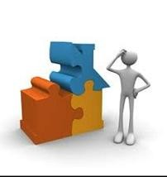
Software Architecture
Software Architecture
What is Architecture?
Why Architecture is important?
Software Architecture

Slide 12
What is Architecture?
Architecture (ANSI/IEEE 1471-2000)
The fundamental organization of a system embodied in its components, their relationships to each other, and to the environment, and the principles guiding its design and evolution
* Reference [5]

Slide 13
Architecture (Cont...)
Architecture is:
All about communication.
What ‘parts’ are there?
How do the ‘parts’ fit together?
Architecture is not:
About development.
About algorithms.
About data structures.

Slide 14
Why Architecture is important?
Architecture “constitutes a relatively small, intellectually graspable model of how the system is structured and how its components work together” -- L. Bass
Representations of software architecture are an enabler for communication between all parties (stakeholders) interested in the development of a computer-based system.
* Reference [6]

Slide 15
Software Architecture
Software Architecture (Eoin Woods)
“Software architecture is the set of design decisions which, if made incorrectly, may cause you project to be cancelled.’
A software architecture defines:
The components of the software system
How the components use each other’s functionality and data
How control is managed between the components

Slide 16
Software Design Vs Architecture

Slide 17
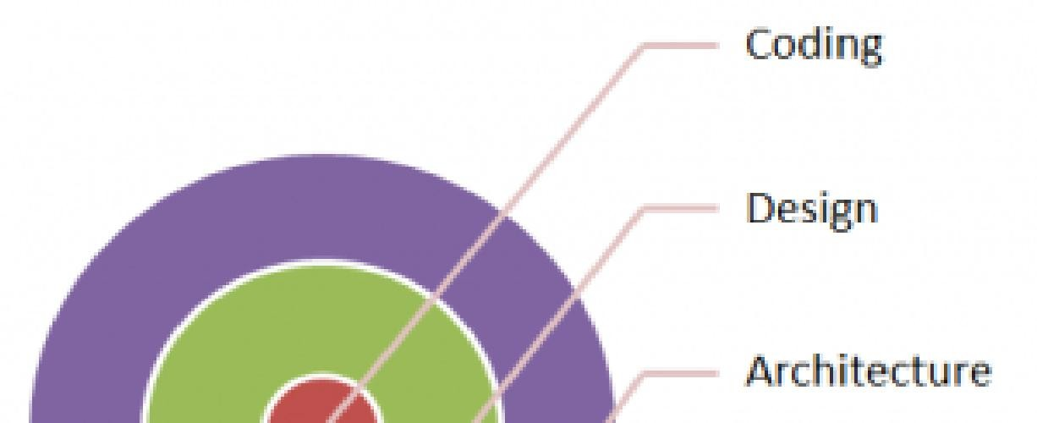

What is Software Architecture?
A software architecture is typically a set of design decisions to address various
non-functional requirements and attributes of a
software
system/application.
It primarily focuses on aspects such as performance, reliability, scalability, testability, maintainability and various other attributes, which can be key both structurally and behaviourally of a software system.
* Reference [7]

Slide 18
Software Design Vs Architecture
Grady Booch says: "All architecture is design but not all design is architecture".
Software architecture deals with high level concepts without regard to any implementation details. Software design on the other hand takes high level concepts and applies concrete details so that software can be implemented.

Slide 19
Software Design Vs Architecture
The architecture of a system is its 'skeleton'. It's the highest level of abstraction of a system. For example: How do modules interact with each other.
While
Software design is about designing the individual modules / components. What are the responsibilities, functions, of module x? Of class Y?
So in short, Software architecture is more about the design of the entire system, while software design emphasizes on module / component / class level.

Slide 20
Engineering Problem Solving

Slide 21
Activity
The problem specification is as follows: there are six equal matches; connect each match to form four equilateral triangles.

Slide 22
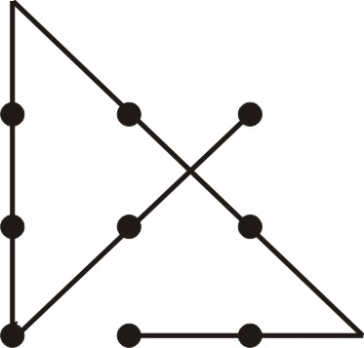
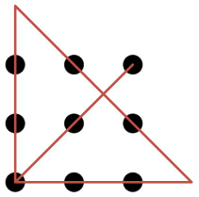
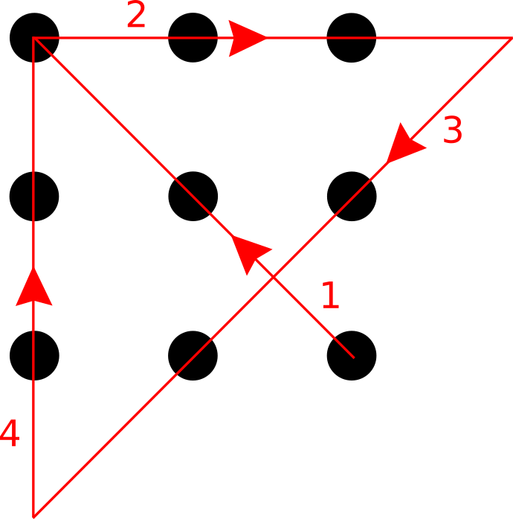

Slide 23
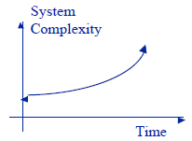
Why study Software Engineering Design ?
Systems are increasingly dependent on software components e.g. microwave oven, washing machine, cars etc. → increased complexity because of embedded software
Maintaining reliability in software-intensive systems is very difficult

Slide 24
Why study Software Engineering Design
The reasons for studying software engineering design can be described using a :
Product development perspective
Project management perspective.

Slide 25
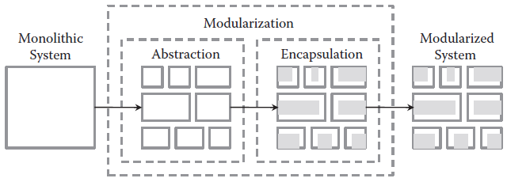
Product Development Perspective
designs form the foundation for all other software construction activities → create models that represent the structure and behavior of the software system
modularization, cohesiveness, and coupling, are all born in the design phase
For complex tasks, abstractions and encapsulation are used in software design as means to provide a systematic approach for problem solving
software designs are reusable
Notes:
Abstraction is the method of hiding the unwanted information. Whereas encapsulation is a method to hide the data in a single entity or unit along with a method to protect information from outside

Slide 26
Project Management Perspective
Changing requirements, tight schedules, cost constraints, high expectations for software quality etc.
Software design helps to accommodate changes to the requirements or system updates, therefore minimizing impact on schedule, cost, and quality.
Helps in tasks allocation to human resources in efficient way

Slide 27
Software Design Challenges
Requirements Volatility
Process
Technology
Ethical and Professional Practices
Managing Design Influences
Stakeholders
Development Organization’s Structure

Slide 28
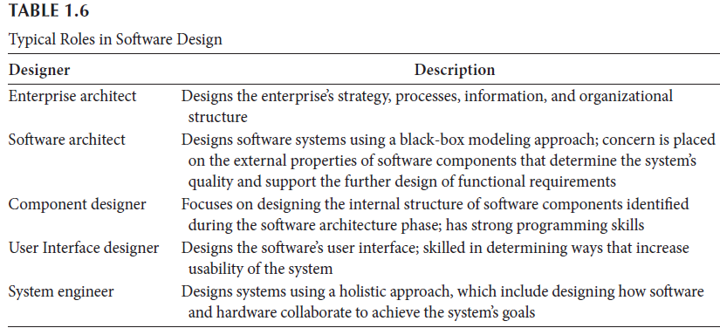
Roles Of The Software Designer

Slide 29
References
http://java.dzone.com/articles/challenges-requirements
http://eduhunch.com/why-design-is-the-most-important- factor-for-future-products/
http://www.informationweek.com/mobile/mobile-devices/10- best-and-worst-cellphones-of-all-time/d/d- id/1109416?page_number=6
http://en.wikipedia.org/wiki/Sustainable_design
http://en.wikipedia.org/wiki/IEEE_1471
Software architecture in practice by Len Bass, Clements, Rick Kazman
http://www.prowareness.com/blog/software-architecture/
Chapter 1: “software engineering design, theory and practice by Carlos -E-Otero ”
Paul

